Slide 1
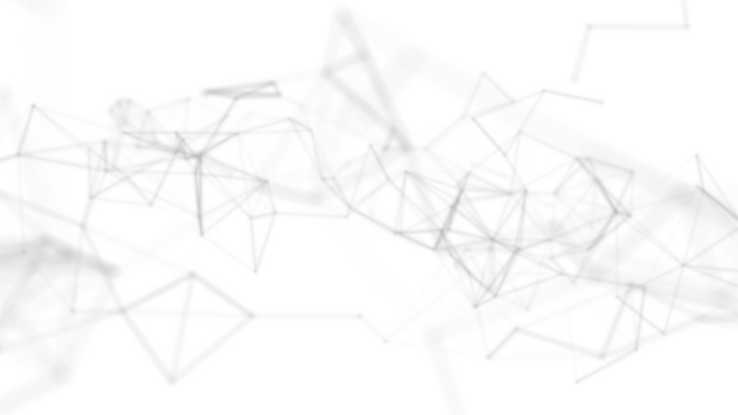
CSE 411: Machine Learning
Bayesian Decision Theory
Dr Muhammad Abul Hasan
Modified By
Abrar Hasan

Slide 2
Probability and Inference
Bayes’ Rule
Association Rules
Apriori Algorithm
Outline
Probability and Inference
Bayes’ Rule
Association Rules
Apriori Algorithm
CSE 411: Machine Learning

Slide 3
“
Tell me and I forget. Teach me and I remember. Involve me and I learn.
”
– Benjamin Franklin

Slide 4
Probability and Inference
Bayes’ Rule
Association Rules
Apriori Algorithm
Probability and Inference
CSE 411: Machine Learning

Slide 5

Probability and Inference
Bayes’ Rule
Association Rules
Apriori Algorithm
Probability and Inference
Result of tossing a coin is ∈ {Heads, Tails}
Random variable X ∈ {1, 0},
X
(1−X)
Bernoulli ∶ P {
X = 1} = p ⋅ (
1 − p)
o
o
t N
Sample: X = {x }
t=1
N
Estimation ∶ p_{o} = = ∑_{t}
#{Heads}
_{x}t
#{Tosses}
Prediction of next toss: Heads if p_{o} > ¹ , Tails otherwise
2
CSE 411: Machine Learning

Slide 6
Probability and Inference
Bayes’ Rule
Association Rules
Apriori Algorithm
Classification
Credit scoring:
Inputs are income and savings. Output is low-risk vs high-risk.
Input: x = [x₁, x₂]^{T} , Output: C ∈ {0, 1}.
Prediction:
C = 1 if P (C = 1∣x₁, x₂) > 0.5
choose {
C = 0 otherwise
or
C = 1 if P (C = 1∣x₁, x₂) > P (C = 0∣x₁, x₂)
choose {
C = 0 otherwise
CSE 411: Machine Learning

Slide 7
Probability and Inference
Bayes’ Rule
Association Rules
Apriori Algorithm
Bayes’ Rule
CSE 411: Machine Learning

Slide 8
Probability and Inference
Bayes’ Rule
Association Rules
Apriori Algorithm
Prior Probability
Prior probability is a fundamental concept in Bayesian Decision Theory, which represents the initial belief about a hypothesis before any evidence or data is taken into account.
Imagine you're analyzing the likelihood of a patient having a particular Polio.
Based on historical data, you know that 2% of the population has the disease.
This 2% represents the prior probability
P(Disease)=0.02
CSE 411: Machine Learning

Slide 9
Probability and Inference
Bayes’ Rule
Association Rules
Apriori Algorithm
Joint Probability
Joint probability refers to the probability of two (or more) events happening simultaneously.
In mathematical terms, for two events A and B,
the joint probability is denoted as P(A∩B) or simply P(A,B).
CSE 411: Machine Learning

Slide 10
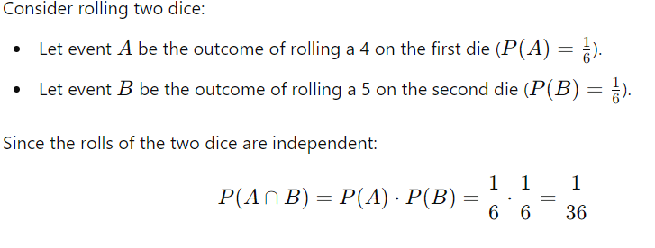
Probability and Inference
Bayes’ Rule
Association Rules
Apriori Algorithm
Example
CSE 411: Machine Learning

Slide 11
The chain rule in probability allows us to express the joint probability of two events A and B as:
P(A∩B) =P(A∣B)⋅P(B)

Slide 12
Probability and Inference
Bayes’ Rule
Association Rules
Apriori Algorithm
Marginal Probability
Marginal probability refers to the probability of an event occurring irrespective of the outcome of other variables or events. It is derived from joint probabilities by summing (or integrating) over the probabilities of all possible outcomes of the other event(s).
CSE 411: Machine Learning

Slide 13
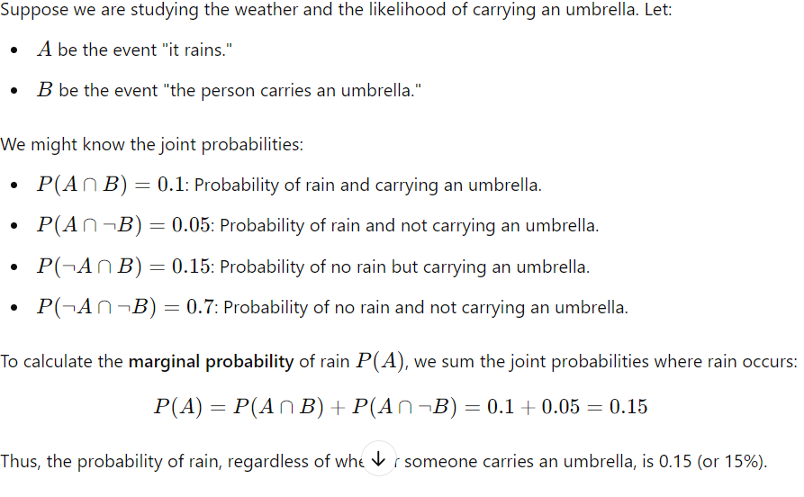

Slide 14
Probability and Inference
Bayes’ Rule
Association Rules
Apriori Algorithm
Conditional Probability
Conditional probability refers to the probability of an event occurring, given that another related event has already occurred.
Conditional probability is denoted as
P(A∣B), which reads "the probability of A given B."
CSE 411: Machine Learning

Slide 15
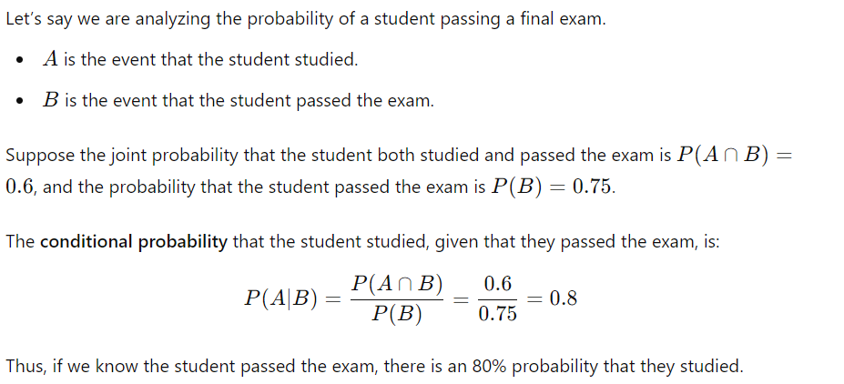

Slide 16
Probability and Inference
Bayes’ Rule
Association Rules
Apriori Algorithm
Likelihood vs Posterior Probability
Likelihood refers to the probability of the observed data given a particular hypothesis. It represents how well the data supports a specific hypothesis.
Example:
Imagine you're testing a coin to determine if it is fair. Your hypothesis HHH is that the coin has a 50% chance of landing heads. If you flip the coin 10 times and observe 7 heads
CSE 411: Machine Learning

Slide 17
Probability and Inference
Bayes’ Rule
Association Rules
Apriori Algorithm
Likelihood vs Posterior Probability
Posterior probability is the probability of a hypothesis being true after considering the observed evidence or data.
Example:
Imagine you're testing a coin to determine if it is fair. Your hypothesis H is that the coin has a 50% chance of landing heads. If you flip the coin 10 times and observe 7 heads
CSE 411: Machine Learning

Slide 18
Probability and Inference
Bayes’ Rule
Association Rules
Apriori Algorithm
Bayes’ Rule
P ( x ∣ C ) p (C )
P ( C ∣ x ) =
p(x)
where,
p( C ∣ x ) is posterior;
p( x ∣ C ) is likelihood;
p( C ) is prior;
p( x ) is evidence.
CSE 411: Machine Learning

Slide 19
Probability and Inference
Bayes’ Rule
Association Rules
Apriori Algorithm
Bayes’ Rule: K = 2 Classes
Marginal Probability
Chain Rule: P(A∩B) =P(A∣B)⋅P(B)
P(x) = P( x ∣ C=1) * P(C = 1) + P(x ∣ C=0) * P( C = 0 )
CSE 411: Machine Learning

Slide 20
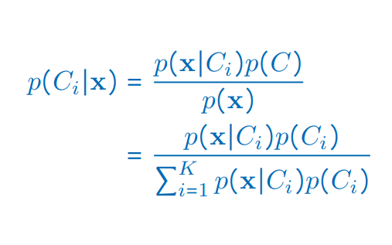
Probability and Inference
Bayes’ Rule
Association Rules
Apriori Algorithm
Bayes’ Rule: K > 2 Classes
CSE 411: Machine Learning

Slide 21
Probability and Inference
Bayes’ Rule
Association Rules
Apriori Algorithm
Association Rules
CSE 411: Machine Learning

Slide 22
Probability and Inference
Bayes’ Rule
Association Rules
Apriori Algorithm
Association Rules
Association rule: X → Y
People who buy/click/visit/enjoy X are also likely to buy/click/visit/enjoy Y.
A rule implies association, not necessarily causation.
CSE 411: Machine Learning

Slide 23
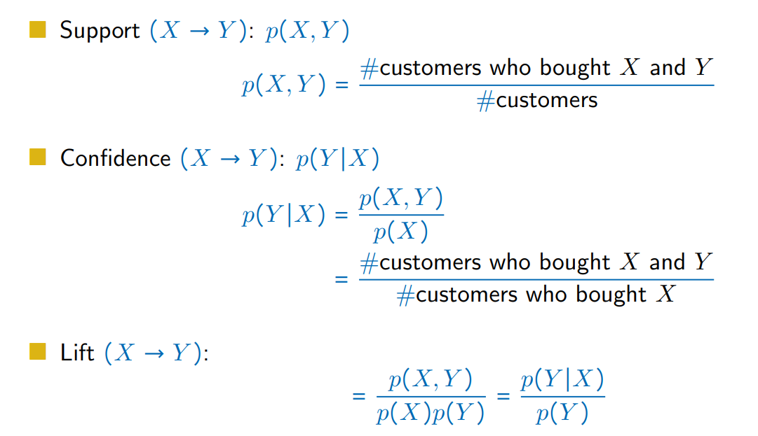
Support
Support measures how frequently an itemset (a group of items) appears in the dataset
Percentage of A customer buys both Banana and Apple

Slide 24
Confidence
Confidence measures the likelihood of seeing item B in a transaction, given that item Ais already present.
What is the probability of a customer to buy a banana after buying an apple

Slide 25
Lift
Lift measures how much more likely item B is purchased when item A is purchased, compared to if B is purchased independently of A

Slide 26
Probability and Inference
Bayes’ Rule
Association Rules
Apriori Algorithm
Association measures
CSE 411: Machine Learning

Slide 27
Probability and Inference
Bayes’ Rule
Association Rules
Apriori Algorithm
Example
Transaction | Items in Baskets
1 | Milk, Bananas, Chocolate
2 | Milk, Chocolate
3 | Milk, Bananas
4 | Chocolate
5 | Chocolate
6 | Milk, Chocolate
Solution:
Milk → Bananas ∶ Support = 2/6, Confidence = 2/4 Bananas → Milk ∶ Support = 2/6, Confidence = 2/2
Milk → Chocolate ∶ Support = 3/6, Confidence = 3/4 Chocolate → Milk ∶ Support = 3/6, Confidence = 3/5
CSE 411: Machine Learning

Slide 28
Probability and Inference
Bayes’ Rule
Association Rules
Apriori Algorithm
Apriori Algorithm
CSE 411: Machine Learning

Slide 29
Probability and Inference
Bayes’ Rule
Association Rules
Apriori Algorithm
Apriori Algorithm (Agrawal et al., 1996)
To generate an association rule
For (X, Y, Z), a 3-item set, to be frequent (have enough Support), (X, Y ),
If (X, Y ) is not frequent, none of its supersets can be frequent.
Once we find the frequent k-item sets, we convert them to rules: X, Y → Z, . . .
and X → Y, Z, . . .
CSE 411: Machine Learning

Slide 30
Probability and Inference
Bayes’ Rule
Association Rules
Apriori Algorithm
Apriori Algorithm (Agrawal et al., 1996)
Reference:
https://www.youtube.com/watch?v=WCK09hVXI9M&t=46s
https://www.youtube.com/watch?v=IVlfuA4LdrU
CSE 411: Machine Learning

Slide 31
Thank You!

